Slide 1

Design and control of the lifting subsystem of a Two-Wheeled Forklift Robot
f
Content
I. Introduction
II. Conceptual design
III. Modeling
IV. Control
V. Simulation
VI. Conclusion
VII. Future work
Sergio Esteban Quintero Benavides
Keio University
Faculty of Science and Technology
School of Integrated Design Engineering
Murakami Laboratory
2nd year – Master’s degree
2025/01/11
SUM Sergio Esteban Quintero Benavides
1

Slide 2



I. Introduction
In modern industrial environments, humans and robots work together.
f
Labor shortage in industrialized countries.
High-risk tasks executed by robots.
[A]
Mobile robots should have a small footprint for safety and space optimization reasons.
[B]
2025/01/11
SUM Sergio Esteban Quintero Benavides
2

Slide 3
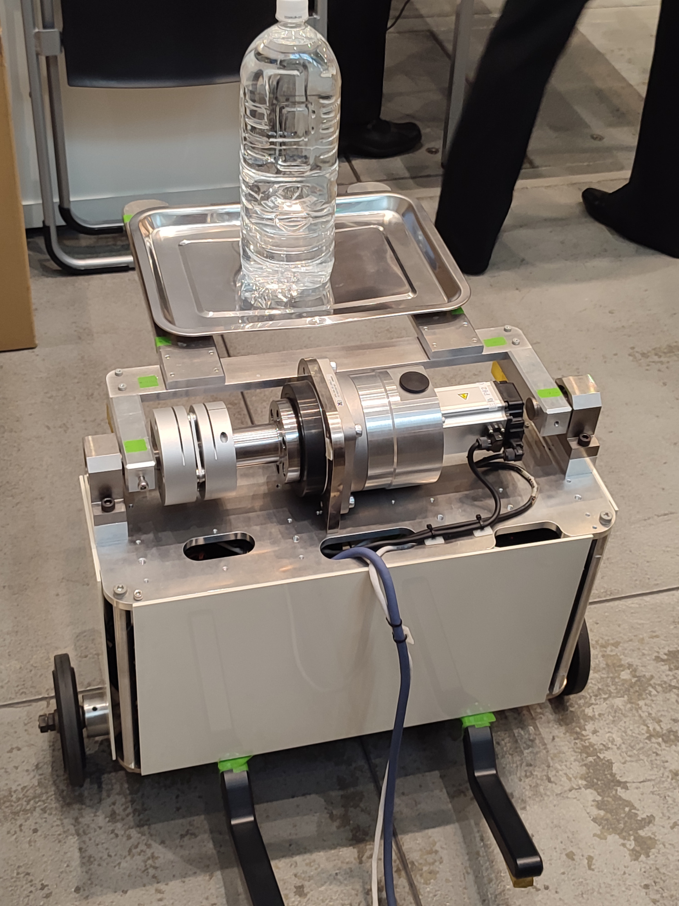

I. Introduction
Two-Wheeled Forklift Robot:
Aimed for load movement in warehouses.
Self-balanced mobile robot.
Small footprint.
[C]
2025/01/11
SUM Sergio Esteban Quintero Benavides
3

Slide 4
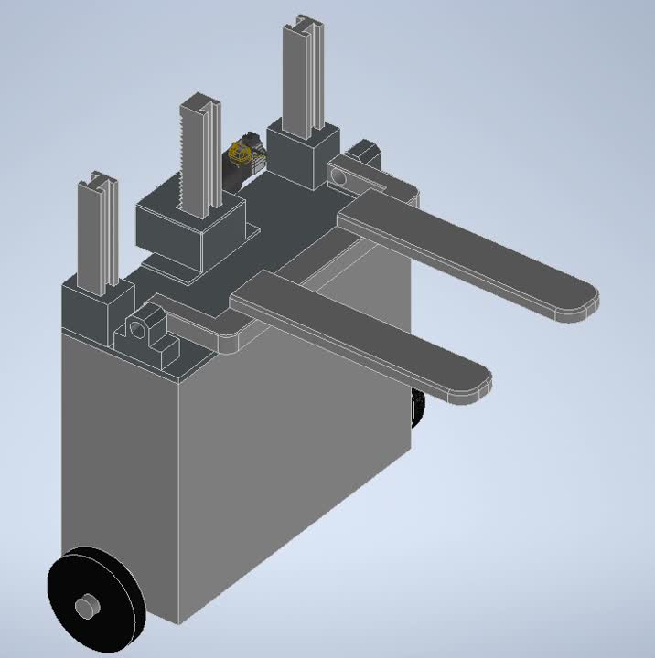
II. Conceptual design
2025/01/11
SUM Sergio Esteban Quintero Benavides
4

Slide 5
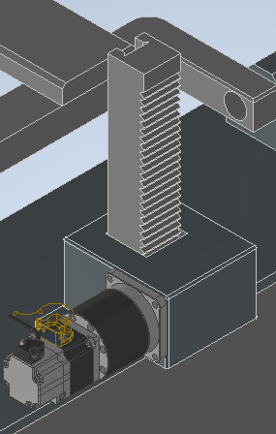
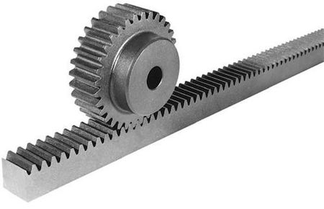
II. Conceptual design
1. Rack and pinion vertical mechanism:
Compact design.
High power transmission.
High precision.
[D]
2025/01/11
SUM Sergio Esteban Quintero Benavides
5

Slide 6
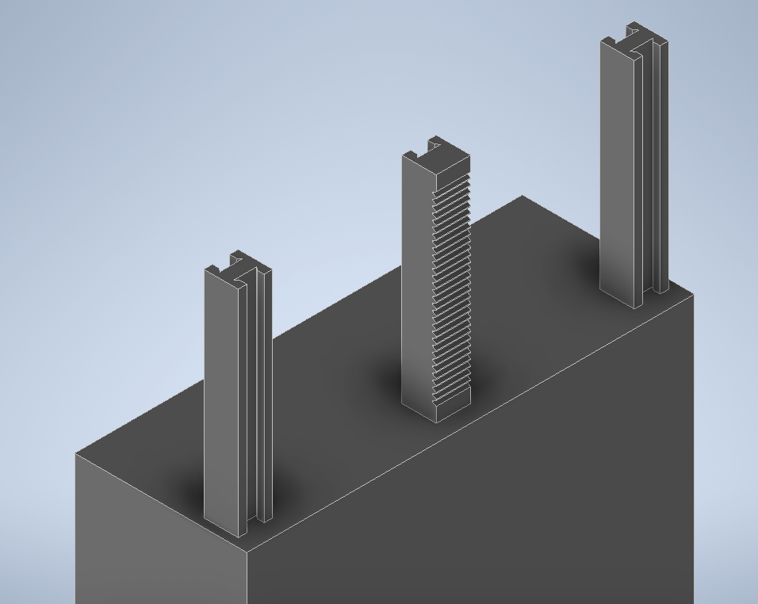
II. Conceptual design
2. Three linear guides for movement rigidity
2025/01/11
SUM Sergio Esteban Quintero Benavides
6

Slide 7
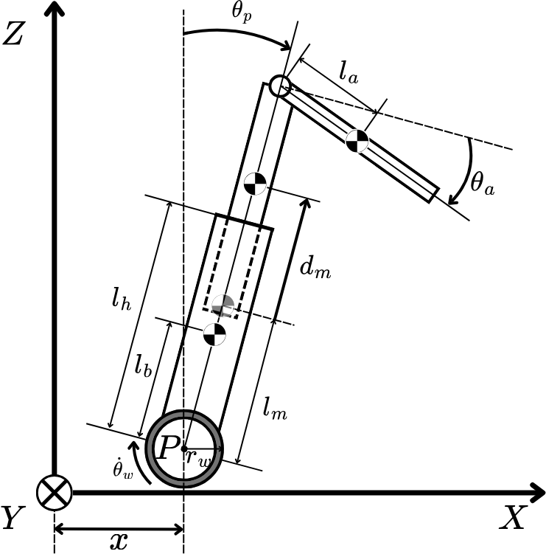
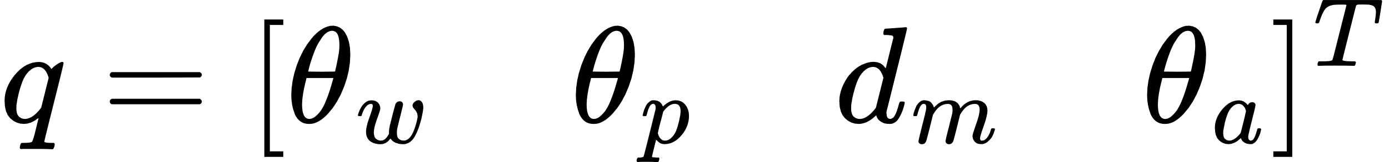
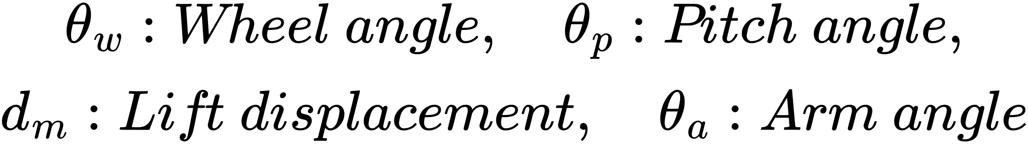
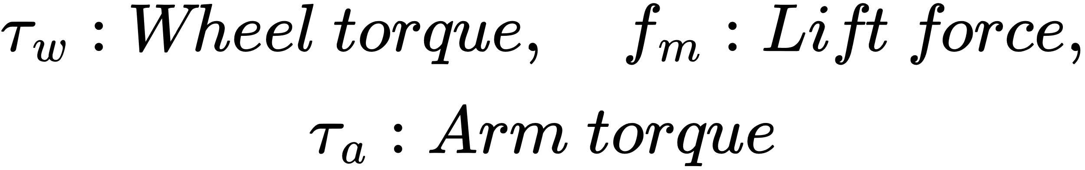
III. Modeling
Lagrange-Euler equation:
Generalized coordinates:
2025/01/11
SUM Sergio Esteban Quintero Benavides
7

Slide 8
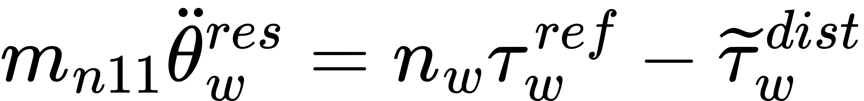
IV. Control
Synthesized Pitch Angle Disturbance Observer (SPADO):
2025/01/11
SUM Sergio Esteban Quintero Benavides
8

Slide 9
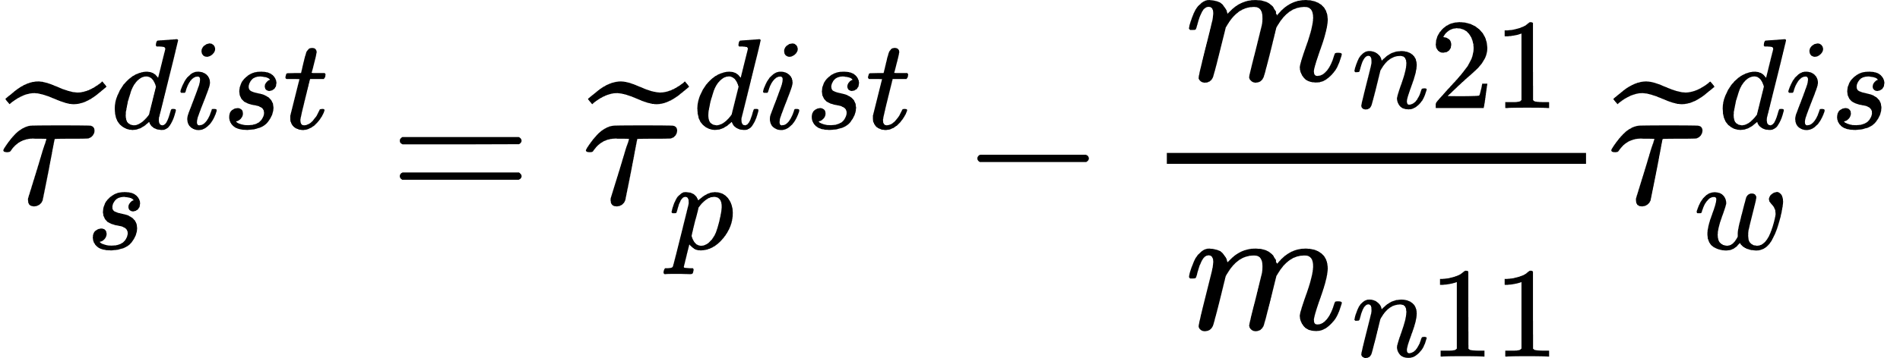
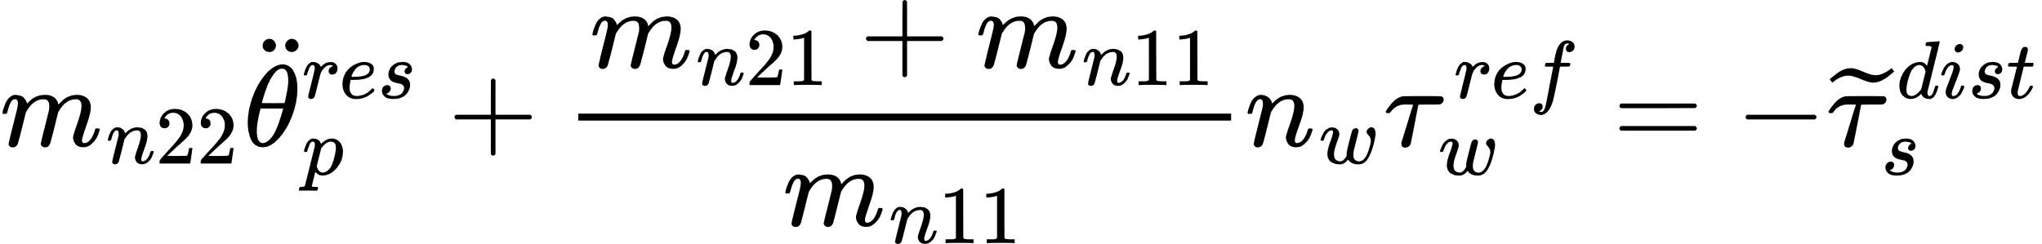
IV. Control
SPADO:
Pseudo differentiation
2025/01/11
SUM Sergio Esteban Quintero Benavides
9

Slide 10
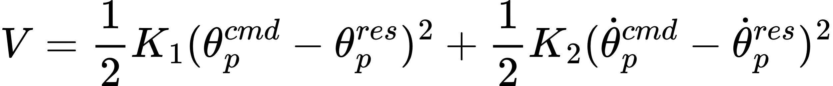
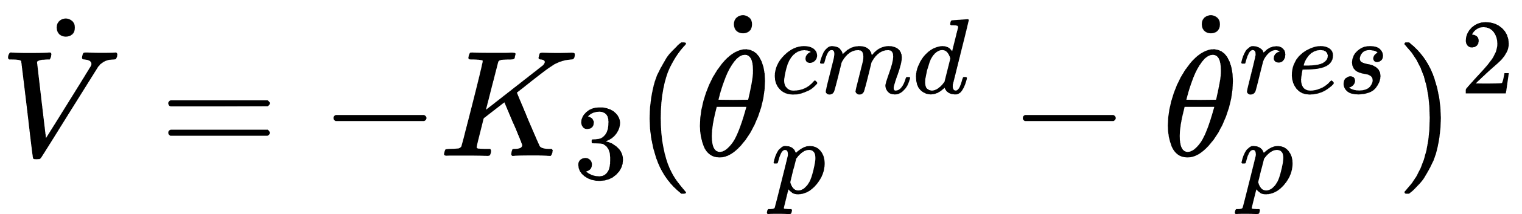
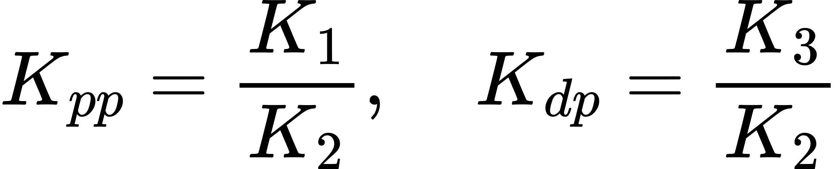
IV. Control
Lyapunov-based PD controller pitch angle:
2025/01/11
SUM Sergio Esteban Quintero Benavides
10

Slide 11
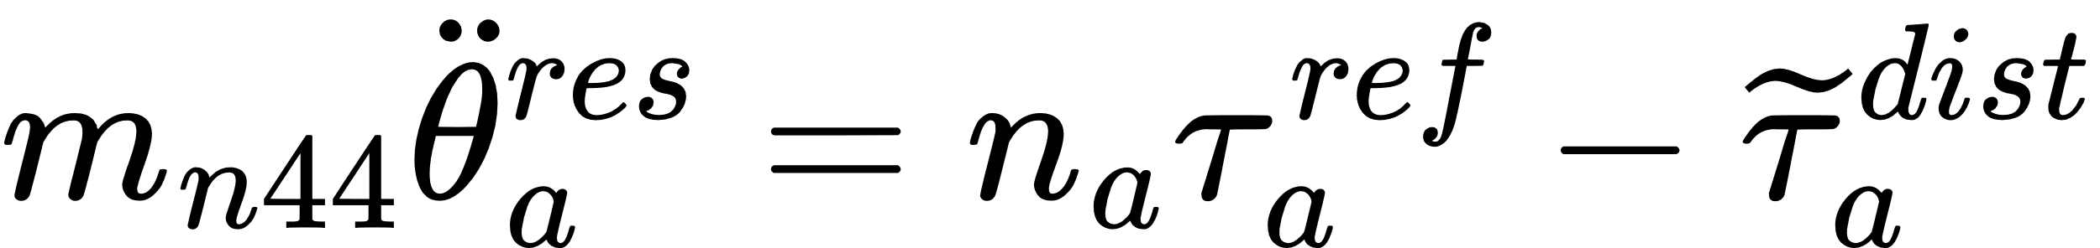
IV. Control
Fork Disturbance Observer (FDOB):
Pseudo differentiation
PD controller fork angle:
2025/01/11
SUM Sergio Esteban Quintero Benavides
11

Slide 12

IV. Control
Reaction Torque Observer (RTOB):
Pseudo differentiation
2025/01/11
SUM Sergio Esteban Quintero Benavides
12

Slide 13
IV. Control
Repulsive Compliance Control (RCC):
PID controller wheel angle:
Total pitch command:
2025/01/11
SUM Sergio Esteban Quintero Benavides
13

Slide 14
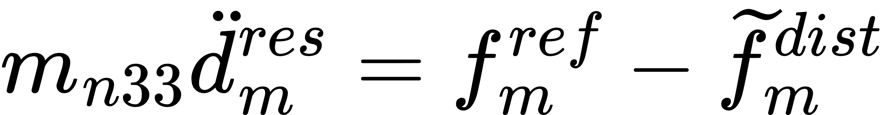
IV. Control
Lift Disturbance Observer (LDOB):
Pseudo differentiation
PD controller lift displacement:
2025/01/11
SUM Sergio Esteban Quintero Benavides
14

Slide 15
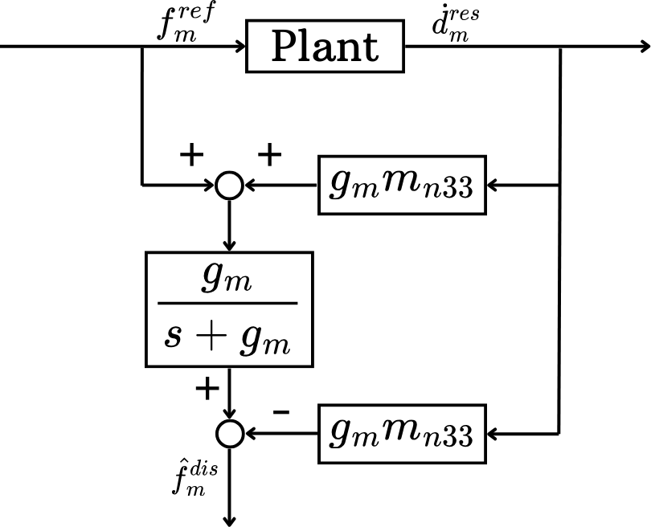
IV. Control
Lift disturbance observer:
2025/01/11
SUM Sergio Esteban Quintero Benavides
15

Slide 16
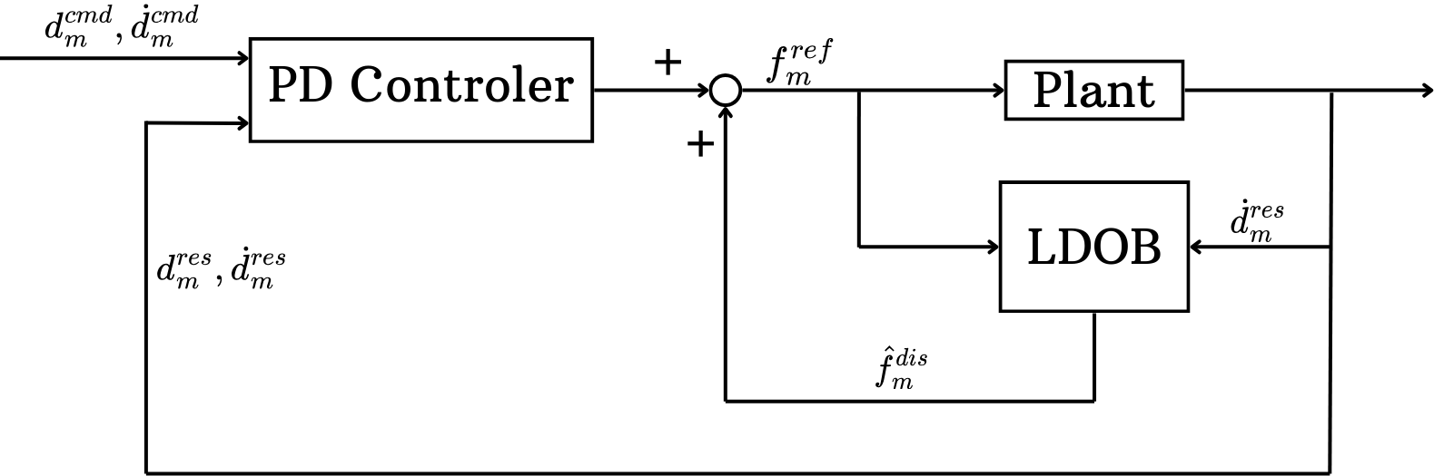
IV. Control
PD controller lift displacement:
2025/01/11
SUM Sergio Esteban Quintero Benavides
16

Slide 17
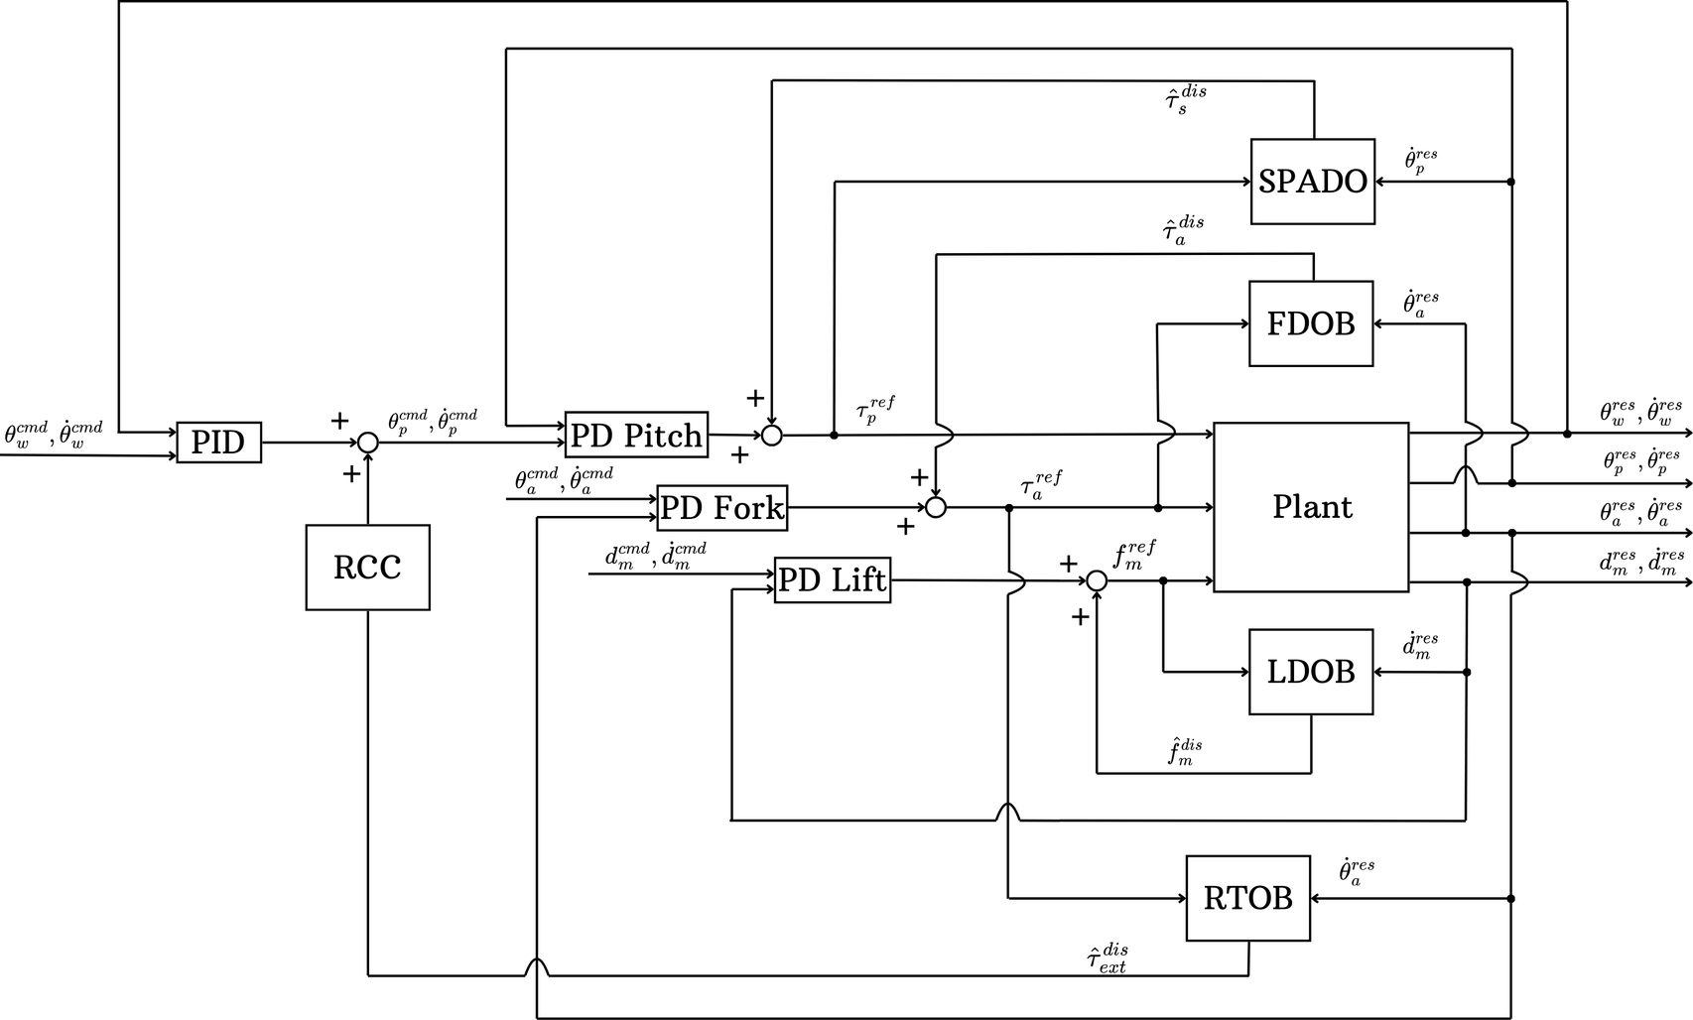
IV. Control
Complete control architecture
2025/01/11
SUM Sergio Esteban Quintero Benavides
17

Slide 18
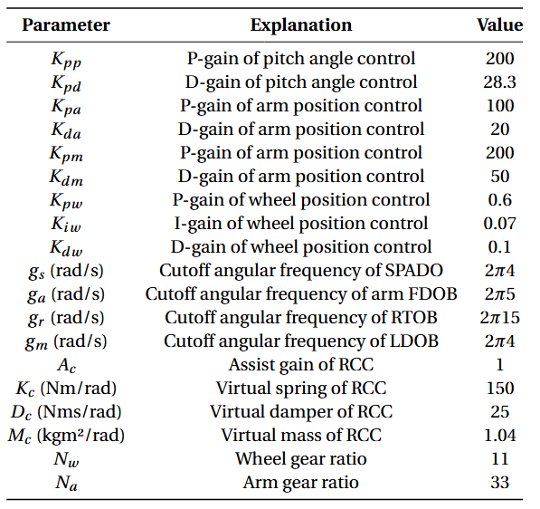
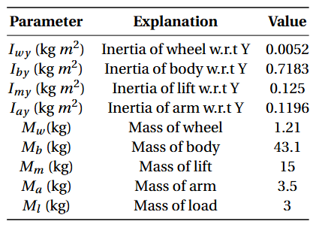
V. Simulation
2025/01/11
SUM Sergio Esteban Quintero Benavides
18

Slide 19
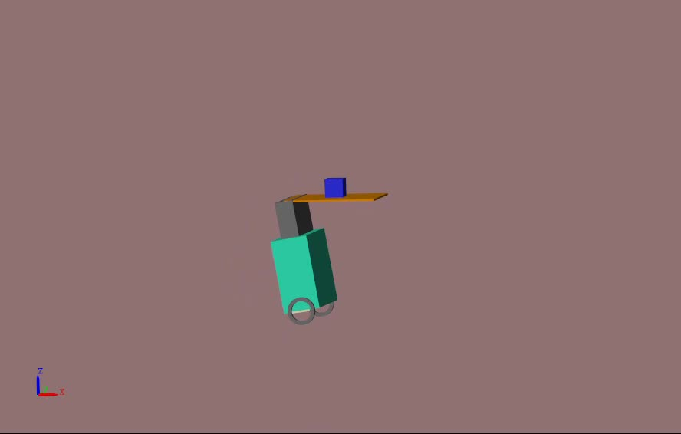
V. Simulation
2025/01/11
SUM Sergio Esteban Quintero Benavides
19

Slide 20
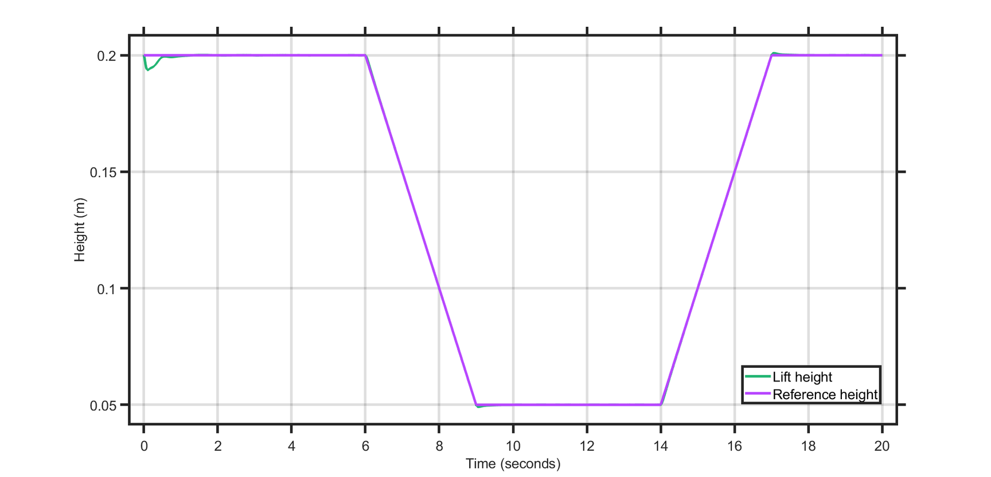
V. Simulation
Vertical displacement of the lift
2025/01/11
SUM Sergio Esteban Quintero Benavides
20

Slide 21
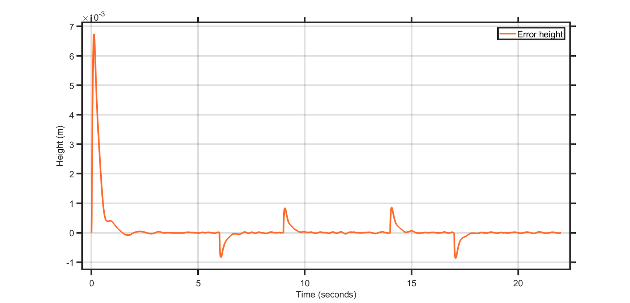
V. Simulation
Displacement error of the lift
2025/01/11
SUM Sergio Esteban Quintero Benavides
21

Slide 22
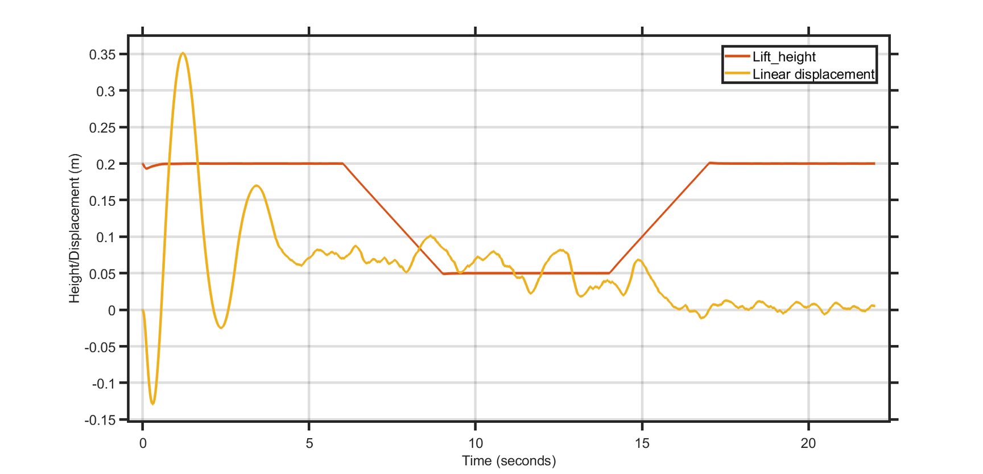
V. Simulation
Horizontal displacement of the robot
2025/01/11
SUM Sergio Esteban Quintero Benavides
22

Slide 23
VI. Conclusion
The proposed mechanical design aims to produce the least number of changes in the current robot.
With the PD controller and LDOB architecture the system can follow vertical displacement references.
The current unified control architecture is not able to follow properly position references with the additional lift subsystem.
2025/01/11
SUM Sergio Esteban Quintero Benavides
23

Slide 24
VII. Future work
Redefine the conceptual design based on the provided feedback and start the detailed mechanical design of the lift subsystem.
Change the current theoretical model to match with the adjusted mechanical design.
Find and fix the cause of the oscillations in the position tracking task.
Propose an alternative control architecture that aimed to directly control the CoG of the robot.
2025/01/11
SUM Sergio Esteban Quintero Benavides
24

Slide 25
References
[1] H. Kanazawa, K. Ishizaki, Y. Miyata, M. Nawa, N. Kato, and T. Murakami, "Model-Based Pitch Angle Compensation for Center of Gravity Variation in Underactuated System with an Arm," in Proceedings of the 2023 IEEE 32nd International Symposium on Industrial Electronics (ISIE), 2023, pp. 1-6.
[2] H. Yajima, K. Ishizaki, Y. Miyata, M. Nawa, N. Kato, and T. Murakami, "Posture Stabilization Control Compensating Variation of Body Center of Gravity in Underactuated System," in Proceedings of the 2023 IEEE International Conference on Mechatronics (ICM), 2023, pp. 1-6.
[3] J. Ito and T. Murakami, "Underactuated Control for Two-Wheeled Mobile Robot with an Arm Using Torque Constraint Conditions and Disturbance Observer," in Proceedings of the 2023 IEEE 32nd International Symposium on Industrial Electronics (ISIE), 2023, pp. 1-6.
[4] Mezawa, M. (2022). Virtual Suspension Control in Two-Wheeled Transport Robot (Master's thesis, Keio University).
[A] https://www.flaticon.com/free-icons/comparison
[B] https://www.flaticon.com/free-icons/standard
[C] https://www.cbinsights.com/investor/toyota-industries-corporation
[D] https://www.motioncontroltips.com/what-is-a-rack-and-pinion/
2025/01/11
SUM Sergio Esteban Quintero Benavides
25

Slide 26
Thank you!
2025/01/11
SUM Sergio Esteban Quintero Benavides
26

